Slide 1
Social Media Analytics Projects
Sub Titles : Google Ads , Facebook And LinkedIn
Team Members :
1) Sudarshan Shantharam Patil 2) Vishaka
3) Chetan Raju khairnar
4) Tasmiya banu
5) Abhishek Shreedhar Yarandoli
6) Joy Ezra
7) Prasad s
Tools: Excel , Tableau , Power BI And SQL

Slide 2
Project Summary
Objective : To perform a comprehensive analysis of social media advertising performance across Facebook, LinkedIn, and Google Ads platforms, identifying key metrics and trends that drive engagement, conversions, and return on investment (ROI)
Goal: Identify top-performing campaigns, engagement trends, and ROI.
Impact: Helps optimize ad strategies, improve targeting, and increase conversions.

Slide 3
KPIS LISI
Facebook
Reach & Impressions
Engagement Rate (Likes, Comments, Shares)
Click-Through Rate (CTR)
Ad Spend vs. ROI
LinkedIn
Post Engagement Rate
Follower Growth
Clicks & Conversions
Campaign Performance by Industry
Google
Click-Through Rate (CTR)
Conversion Rate
Cost Per Click (CPC)
Return on Ad Spend (ROAS)

Slide 4
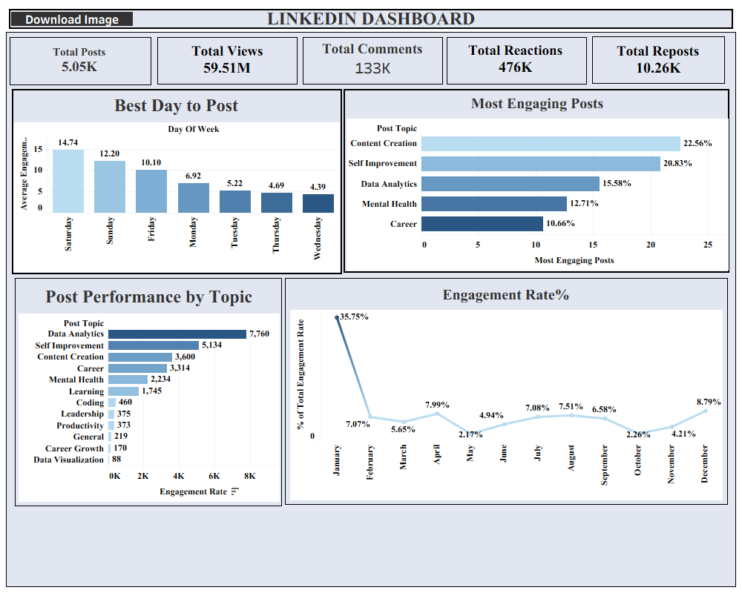
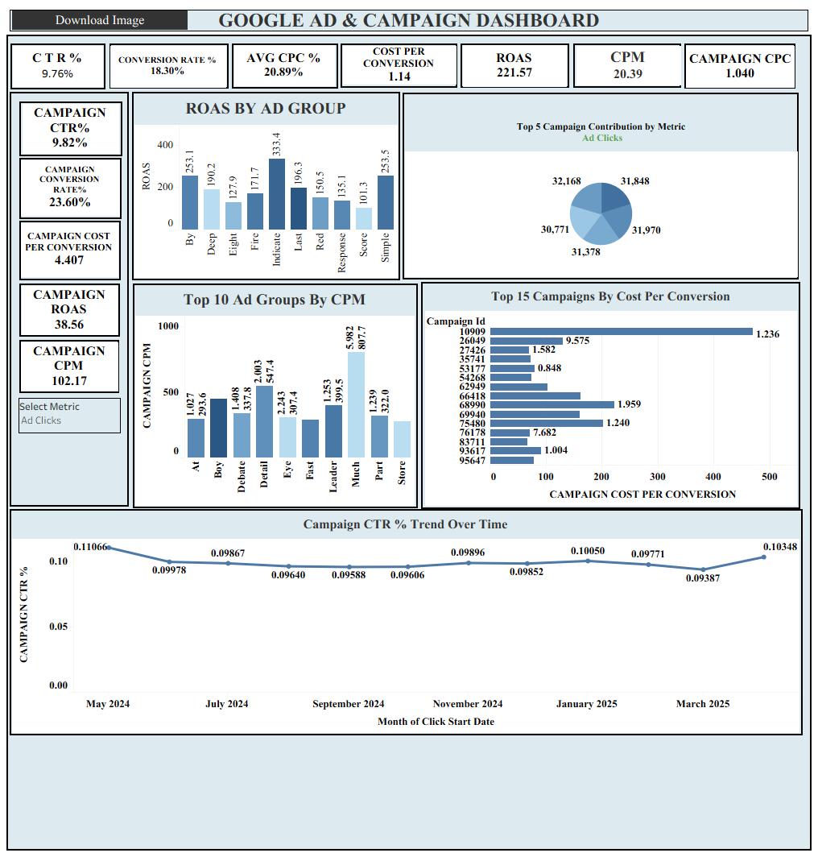
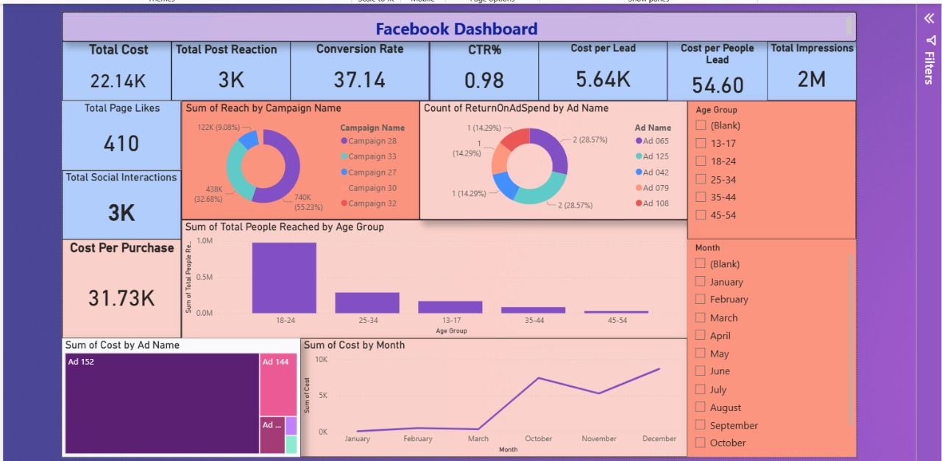

Slide 5
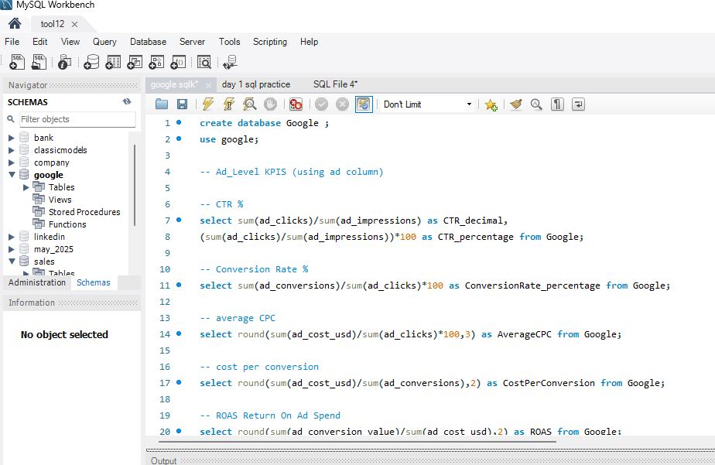
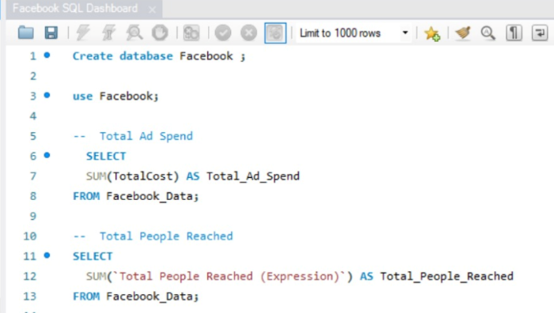
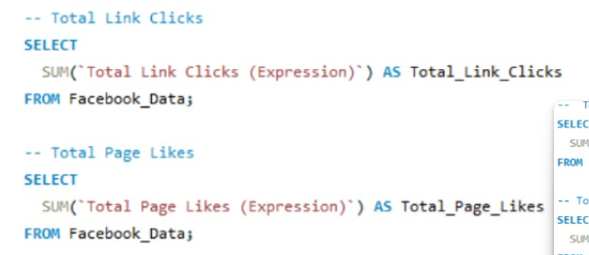
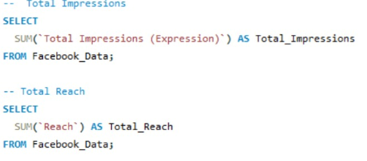

Slide 6
Key Findings And Insights
Major Findings :
Facebook: Highest reach and engagement rate.
LinkedIn: Strong professional audience with higher CTR.
Google: Best ROI through targeted ad spend.
Challenge: Balancing ad cost with engagement across platforms.
Future Recommendation:
  Focus more on Google Ads for conversions.
  Use LinkedIn for B2B lead generation.
  Optimize Facebook campaigns using audience insights.

Slide 7
Conclusion & Learnings
Summary:
Combined Excel, SQL, Tableau, and Power BI for complete analytics workflow.
Created automated and interactive dashboards.
Delivered clear insights into ad performance across platforms.
Learnings:
Strengthened skills in data modeling and visualization.
Gained understanding of marketing KPIs and performance metrics.
Built scalable reporting solutions.
Next Steps:
Connect live APIs for real-time data refresh.
Extend dashboard to include organic traffic and engagement data.

